Slide 1
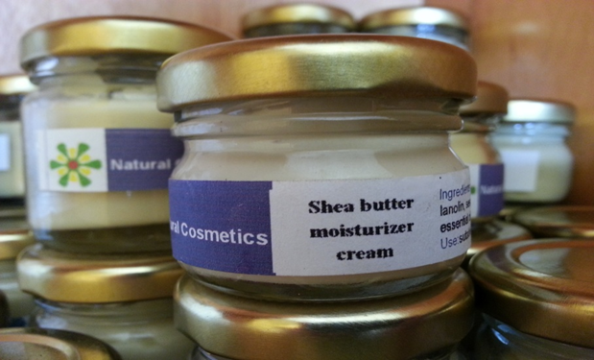
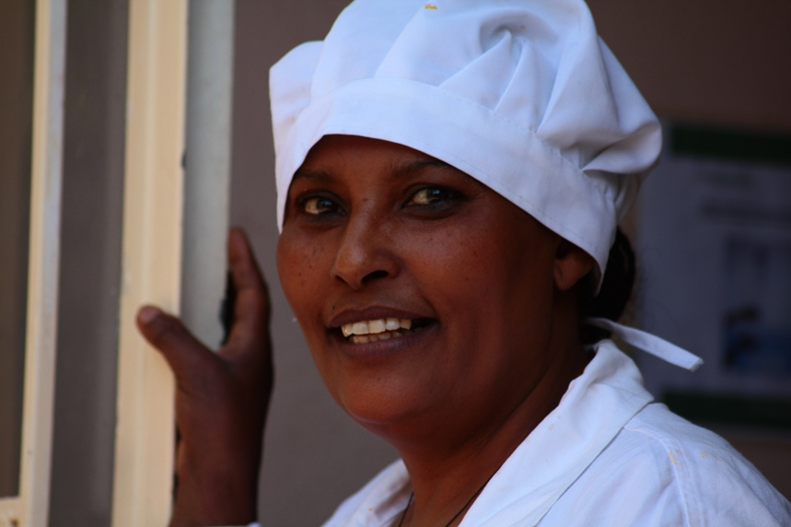
Ecopia Plc has been working over the last 10 years with more than 11,000 local communities in Ethiopian including biosphere reserves (Keffa, Shekia and Yayu) and other hot spots areas that are covered by the convention of biodiversity like in Bale, Gambella, Tigray in income generations activities. In the areas of agro processing and agro-biodiversity. We have established in each sites a processing facilities with the communities. Each site has its own product with its own identifications brand.
Ecopia is a social private company (for profit) that has been an investor partner in this regions in view of establishing social enterprises for growing and processing organic food, cosmetics and herbal medicinal plants.
The management team of the company are also committed to social entrepreneurship values and code of conducts.

Slide 2
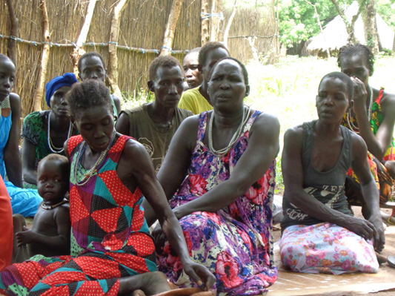
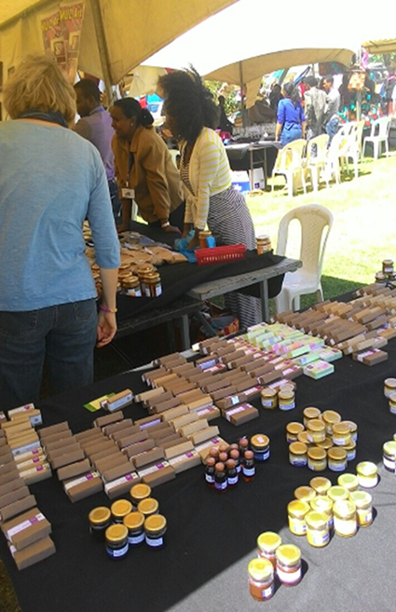
Income and revenue generation for the biodiversity through sustainable management of resources through social enterprise and entrepreneurship.
The farmers are organized as suppliers in cooperative form;
The youth from the communities establish a company with Ecopia;
The company is established as multi purpose processing facilities in order to optimize and manage efficiently the natural resources and the access to the communities.
The communities and the companies of the communities agree on a margin of profit rather than in price;
Each communities based companies use the three licenses of production: food, cosmetics and herbal medicinal plants. The margin of profit from food is between 5 to 15%, from Cosmetics 60% and herbal medicinal plant more than 100%. In some of our sites we are going to integrate now community based integrative tourism that we expect would provide us more job opportunities for the communities.

Slide 3
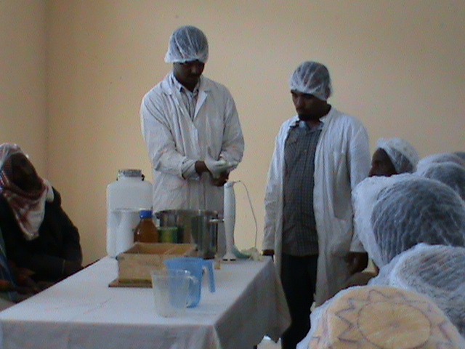
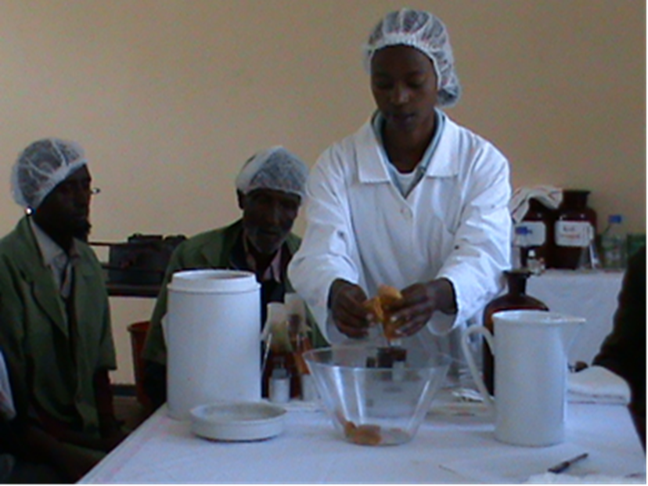
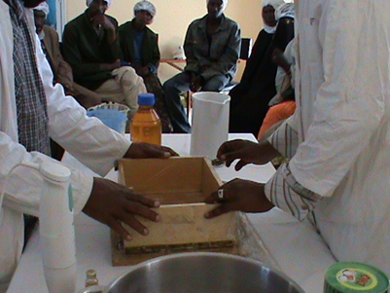
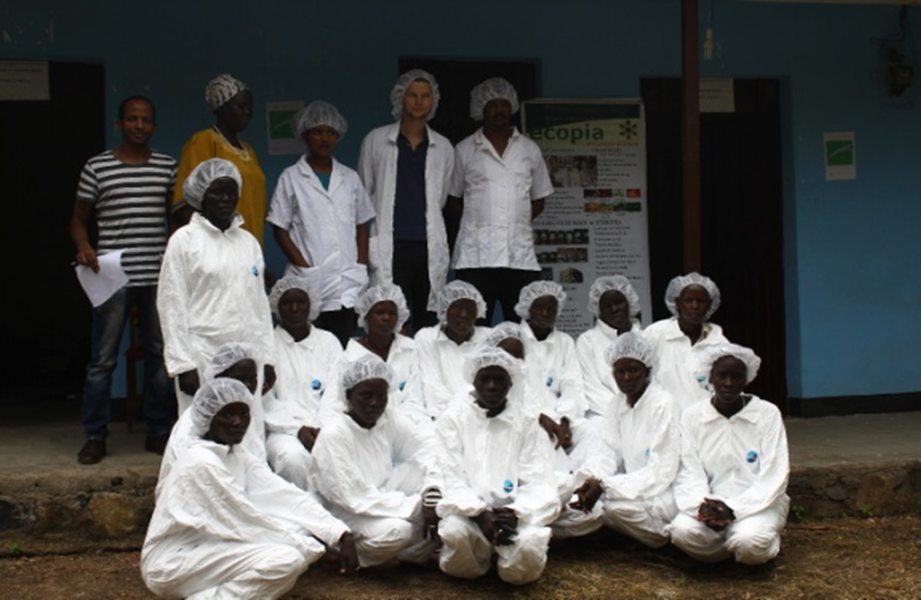
Challenges and opportunities of Social enterprise and entrepreneurship in biosphere reserves in Ethiopia
Requires networking between biosphere reserves within the nation and internationally in order to market products and services;
Community based branding requires a good management of income and revenue;.
Social enterprise and social entrepreneurship within biosphere reserve are the core element of the brand of product and services and could have impact in the margin of profit and
Social enterprises within the biosphere reserve can be linked to CDM and carbon foot print compensation skim generating another income sources.

